Slide 1
Anomaly detection in graphs - past, present and future.
Leman Akoglu CMU
Mary McGlohon Google
Christos Faloutsos CMU

Slide 2
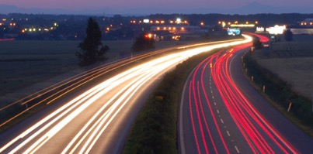
Roadmap
Introduction – Motivation
Past
Present
Future

Slide 3
Roadmap
Introduction – Motivation
Past
Present
Future
Q1) definition?
Q2) automation?
Q3) next steps?

Slide 4
Future – parting thoughts
Q1) Definition of anomaly?
A) “… strange/remote/unlikely, wrt our biases/priors”
Q2) can we automate it?
A) no, but: look for better models/biases/priors
Q3) next steps?
A) cross-disciplinarity -> new+better models

Slide 5
Future – parting thoughts
Q1) Definition of anomaly?
A) “… strange/remote/unlikely, wrt our biases/priors”
Q2) can we automate it?
A) no, but: look for better models/biases/priors
Q3) next steps?
A) cross-disciplinarity -> new+better models

Slide 6
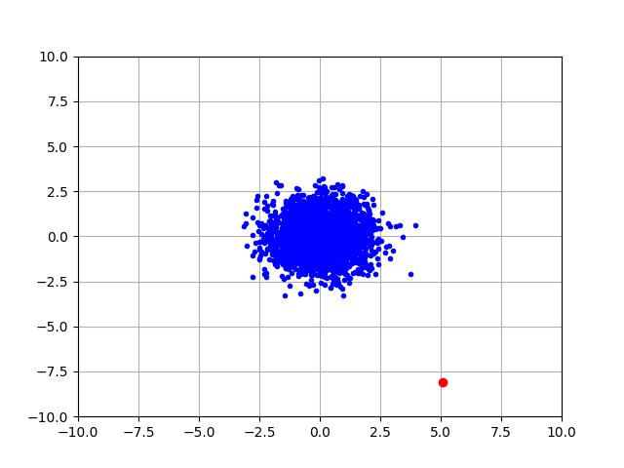
Q1) definition
Hawkins : “an observation which deviates so much from the other observations as to arouse suspicions that it was generated by a different mechanism”
D. M. Hawkins. Identification of outliers, volume 11. Springer, 1980.

Slide 7
Q1) definition
‘deviation from the common rule’
https://www.merriam-webster.com/dictionary/anomaly

Slide 8
Q1) definition
‘deviation from the common rule’
https://www.merriam-webster.com/dictionary/anomaly
But: Who spots the rules?

Slide 9
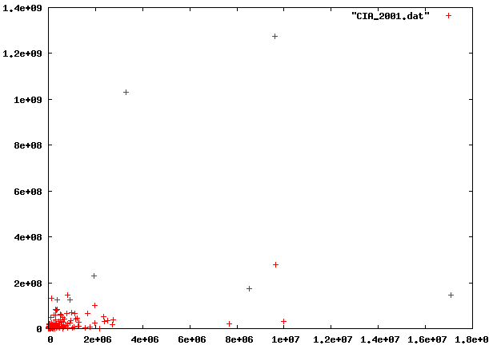
Q1: rules?

Slide 10
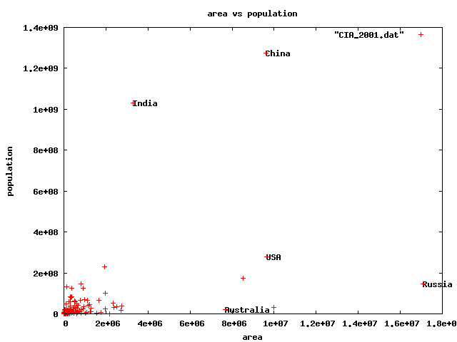
Q1) rules?
🇨🇳
🇮🇳
🇱🇷
🇷🇺

Slide 11
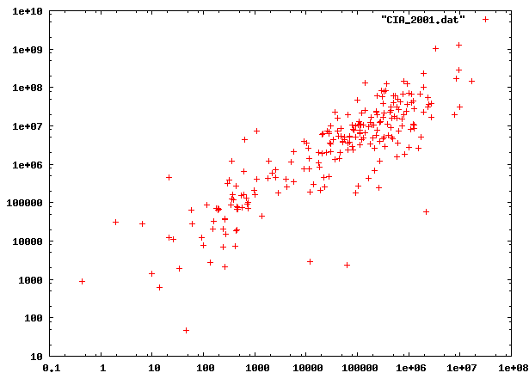
Q1) rules?

Slide 12
Q1) rules?

Slide 13
Q1) rules?

Slide 14
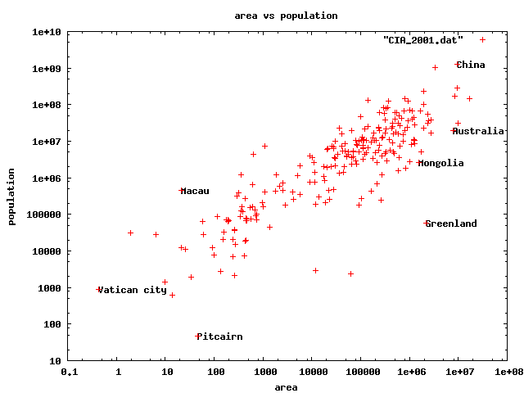
Q1) rules
47 residents(!)

Slide 15
Q1) rules?
47 residents(!)

Slide 16
Q1) definition
‘deviation from the common rule’*
https://www.merriam-webster.com/dictionary/anomaly
* Wrt our rule(s)/biases/axis-scales
But: Who spots the rules?

Slide 17

Q1) definition
Patterns anomalies

Slide 18
Roadmap
Introduction – Motivation
Past
Present
Future
Q1) definition?
Q2) automation?
Q3) next steps?

Slide 19
Future – parting thoughts
Q1) Definition of anomaly?
A) “… strange/remote/unlikely, wrt our biases/priors”
Q2) can we automate it?
A) no, but: look for better models/biases/priors
Q3) next steps?
A) cross-disciplinarity -> new+better models

Slide 20
Q2) automation?
Q2.1
patterns
Q2.2
anomalies
compression

Slide 21
Q2) automation?
Q2.1
patterns
Q2.2
anomalies
compression

Slide 22
Q2) automation?
Q2.1
patterns
Q2.2
anomalies
compression
distance
density

Slide 23
Q2) automation?
Q2.1
patterns
Q2.2
anomalies
compression
distance
density

Slide 24
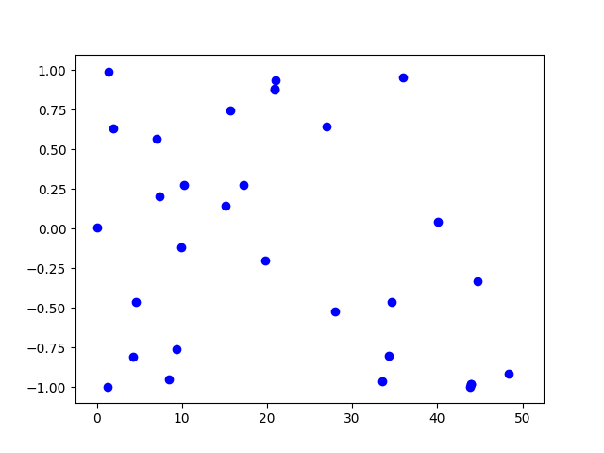
Q2.1) patterns <-> anomalies
Random?

Slide 25
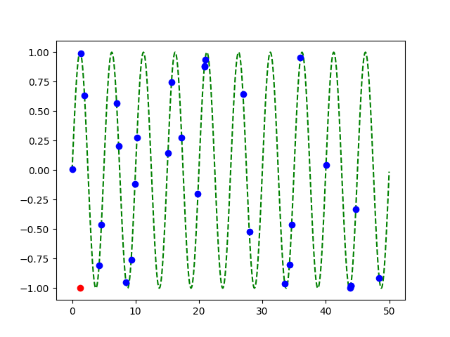
Q2.1) patterns <-> anomalies
Random?
Pattern!
+
Anomaly!

Slide 26
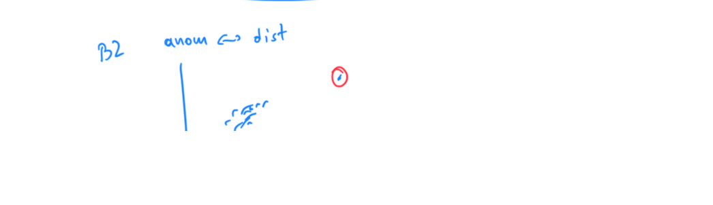

Slide 27
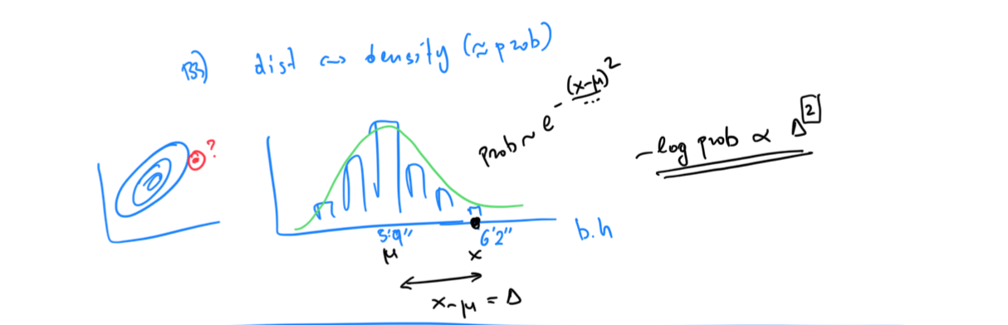

Slide 28
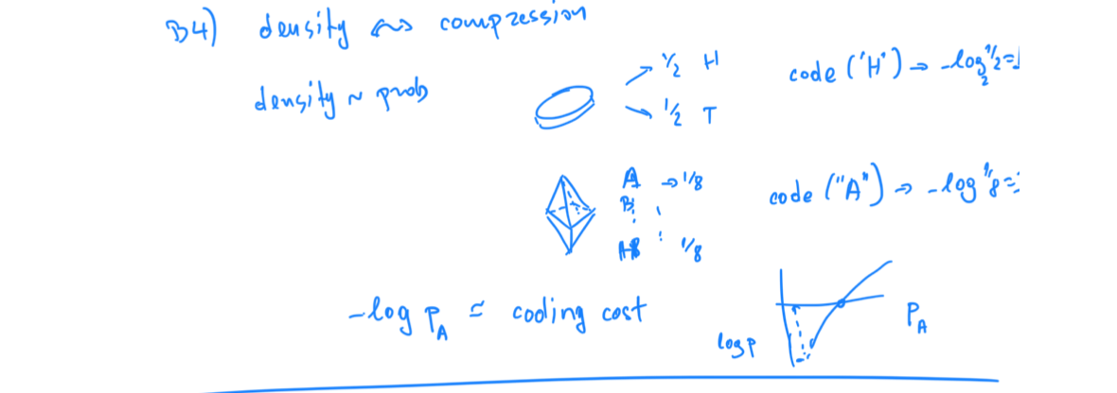

Slide 29
Q2) automation?
✓
Q2.1
patterns
Q2.2
anomalies
compression

Slide 30
Q2) automation?
✓
Q2.1
patterns
Q2.2
anomalies
compression
distance
density

Slide 31
Q2.2) patterns <-> compression
2 int per point
1 int per point
(plus 3 parm’s of sinusoid,
plus 2 int for outlier)

Slide 32
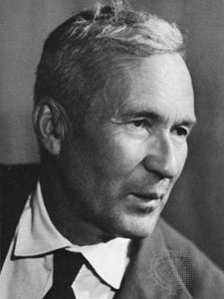
… compression is undecidable!
Theorem*: for an arbitrary string x, computing its Kolmogorov complexity K(x) is undecidable
EVEN WORSE
than NP-hard!
A.N. Kolmogorov
(*) E.g., [T. M. Cover and J. A. Thomas. Elements of Information Theory. John Wiley and Sons,1991, section 7.7]

Slide 33
… compression is undecidable!
…which means there will be a chance to discover better data mining tools / models / patterns
-> job security ☺
-> job satisfaction ☺

Slide 34
Roadmap
Introduction – Motivation
Past
Present
Future
Q1) definition?
Q2) automation?
Q3) next steps?

Slide 35
Examples of models
Fractals / self-similarity (Norway)
Logistic parabola (flies; covid)
Lotka-Volterra
Lorenz attractor (laser / synthetic )
Van der Pol / FitzHugh-Nagumo

Slide 36
Q3.1) models

Slide 37
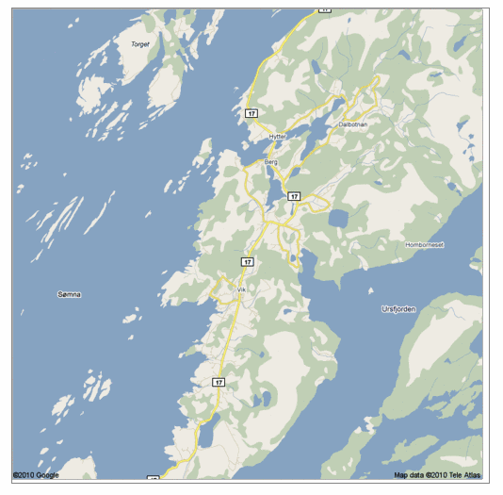
Q: Any pattern?

Slide 38
A: self similar!

Slide 39
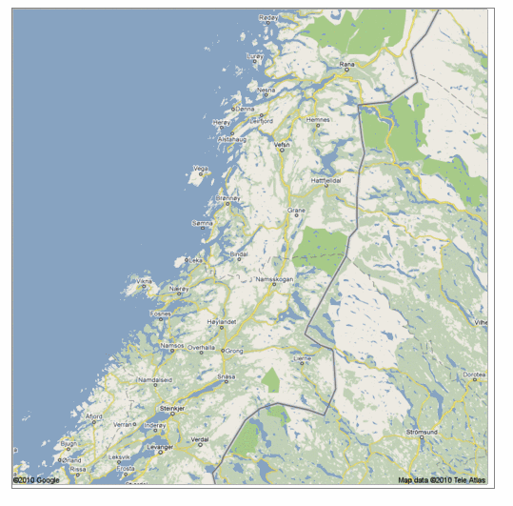
Real, self similar dataset

Slide 40
Real, self similar dataset

Slide 41
Real, self similar dataset

Slide 42
Real, self similar dataset

Slide 43
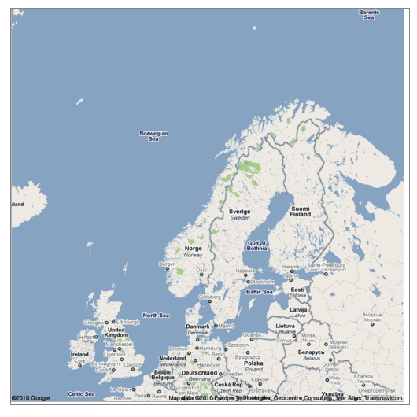
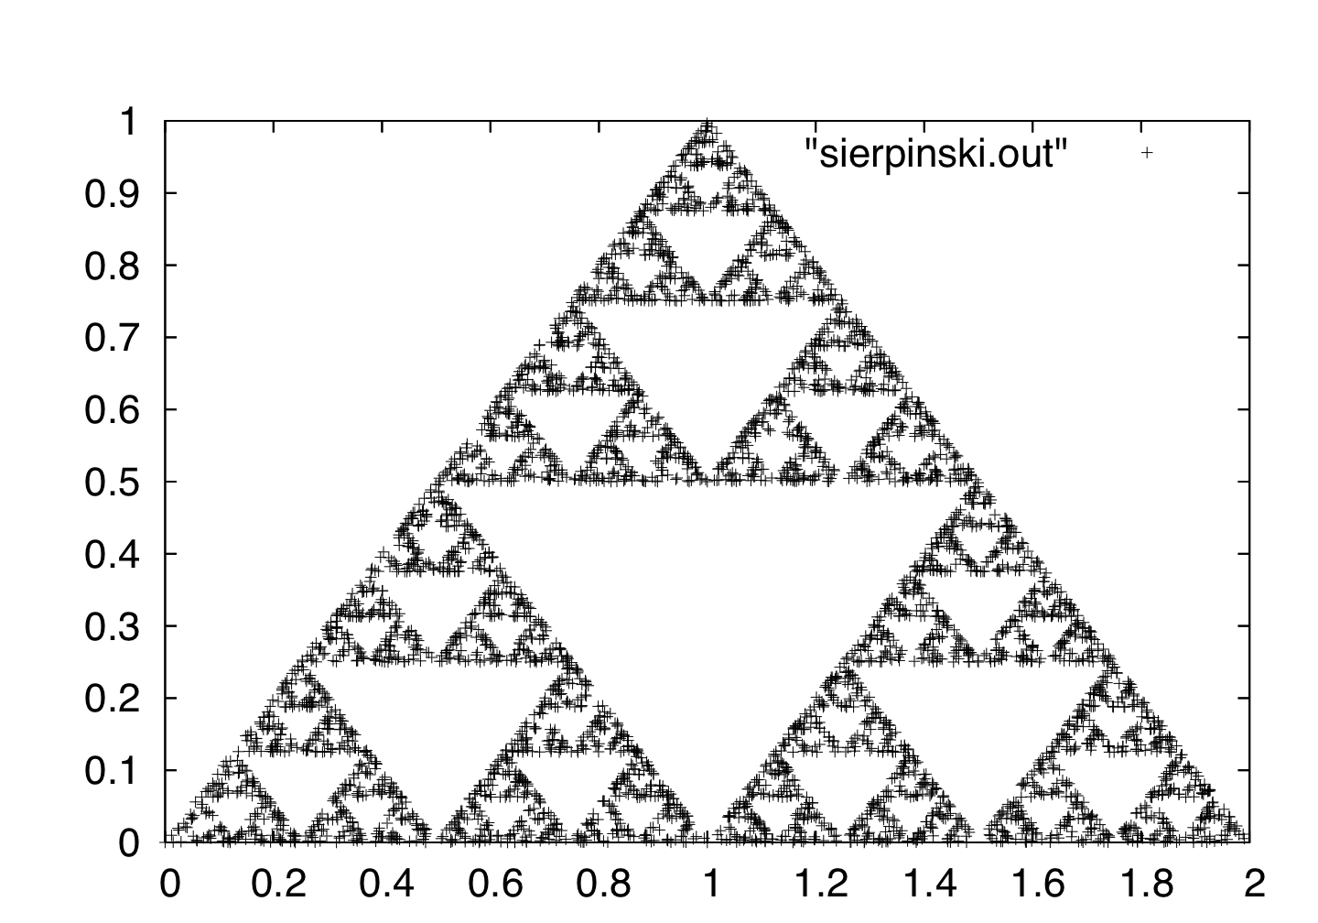
the red is true
origin: Norway
but most other coastlines are ‘self-similar’, too!

Slide 44
Fractals in graphs
Kronecker / Rmat generators

Slide 45
Examples of models
✓
Fractals / self-similarity (Norway)
Logistic parabola (flies; covid)
Lotka-Volterra
Lorenz attractor (laser / synthetic )
Van der Pol / FitzHugh-Nagumo

Slide 46
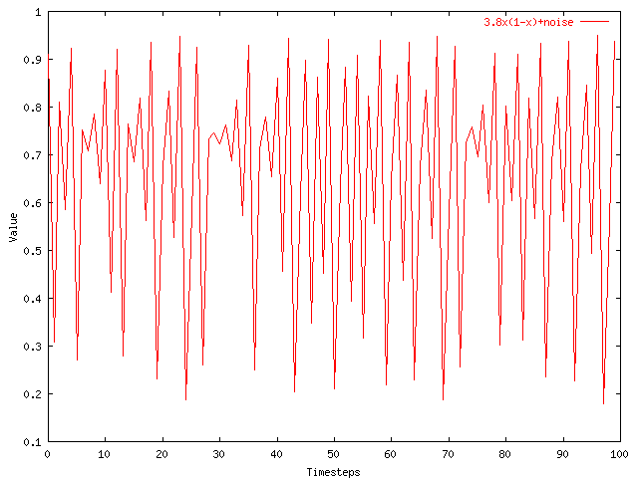
Q3.1) models?
Value
Time

Slide 47

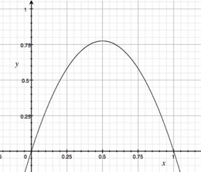
A3.1) Logistic parabola
Models population of flies [R. May/1976]
Logistic map
Time-series plot
Time t
Notes:
x_{t+1} = a x_t \cdot \left( 1-x_t \right )

Slide 48
A3.1) Logistic parabola
Models population of flies [R. May/1976]
Logistic map
= SI virus prop. model
~ Bass equation (market penetration)
Special case of Lotka-Volterra
[COVID-19: SIR]
Notes:
x_{t+1} = a x_t \cdot \left( 1-x_t \right )

Slide 49
Q3) How can we find better models?
A3) Domain experts / cross-disciplinarity

Slide 50
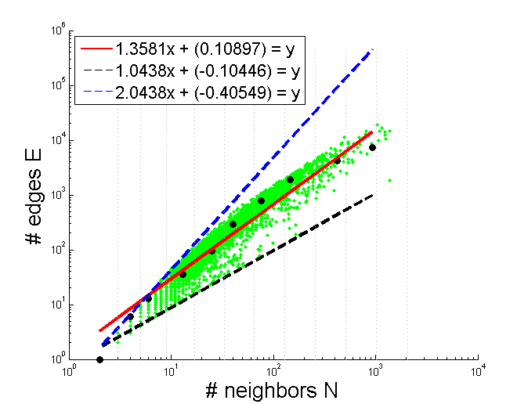
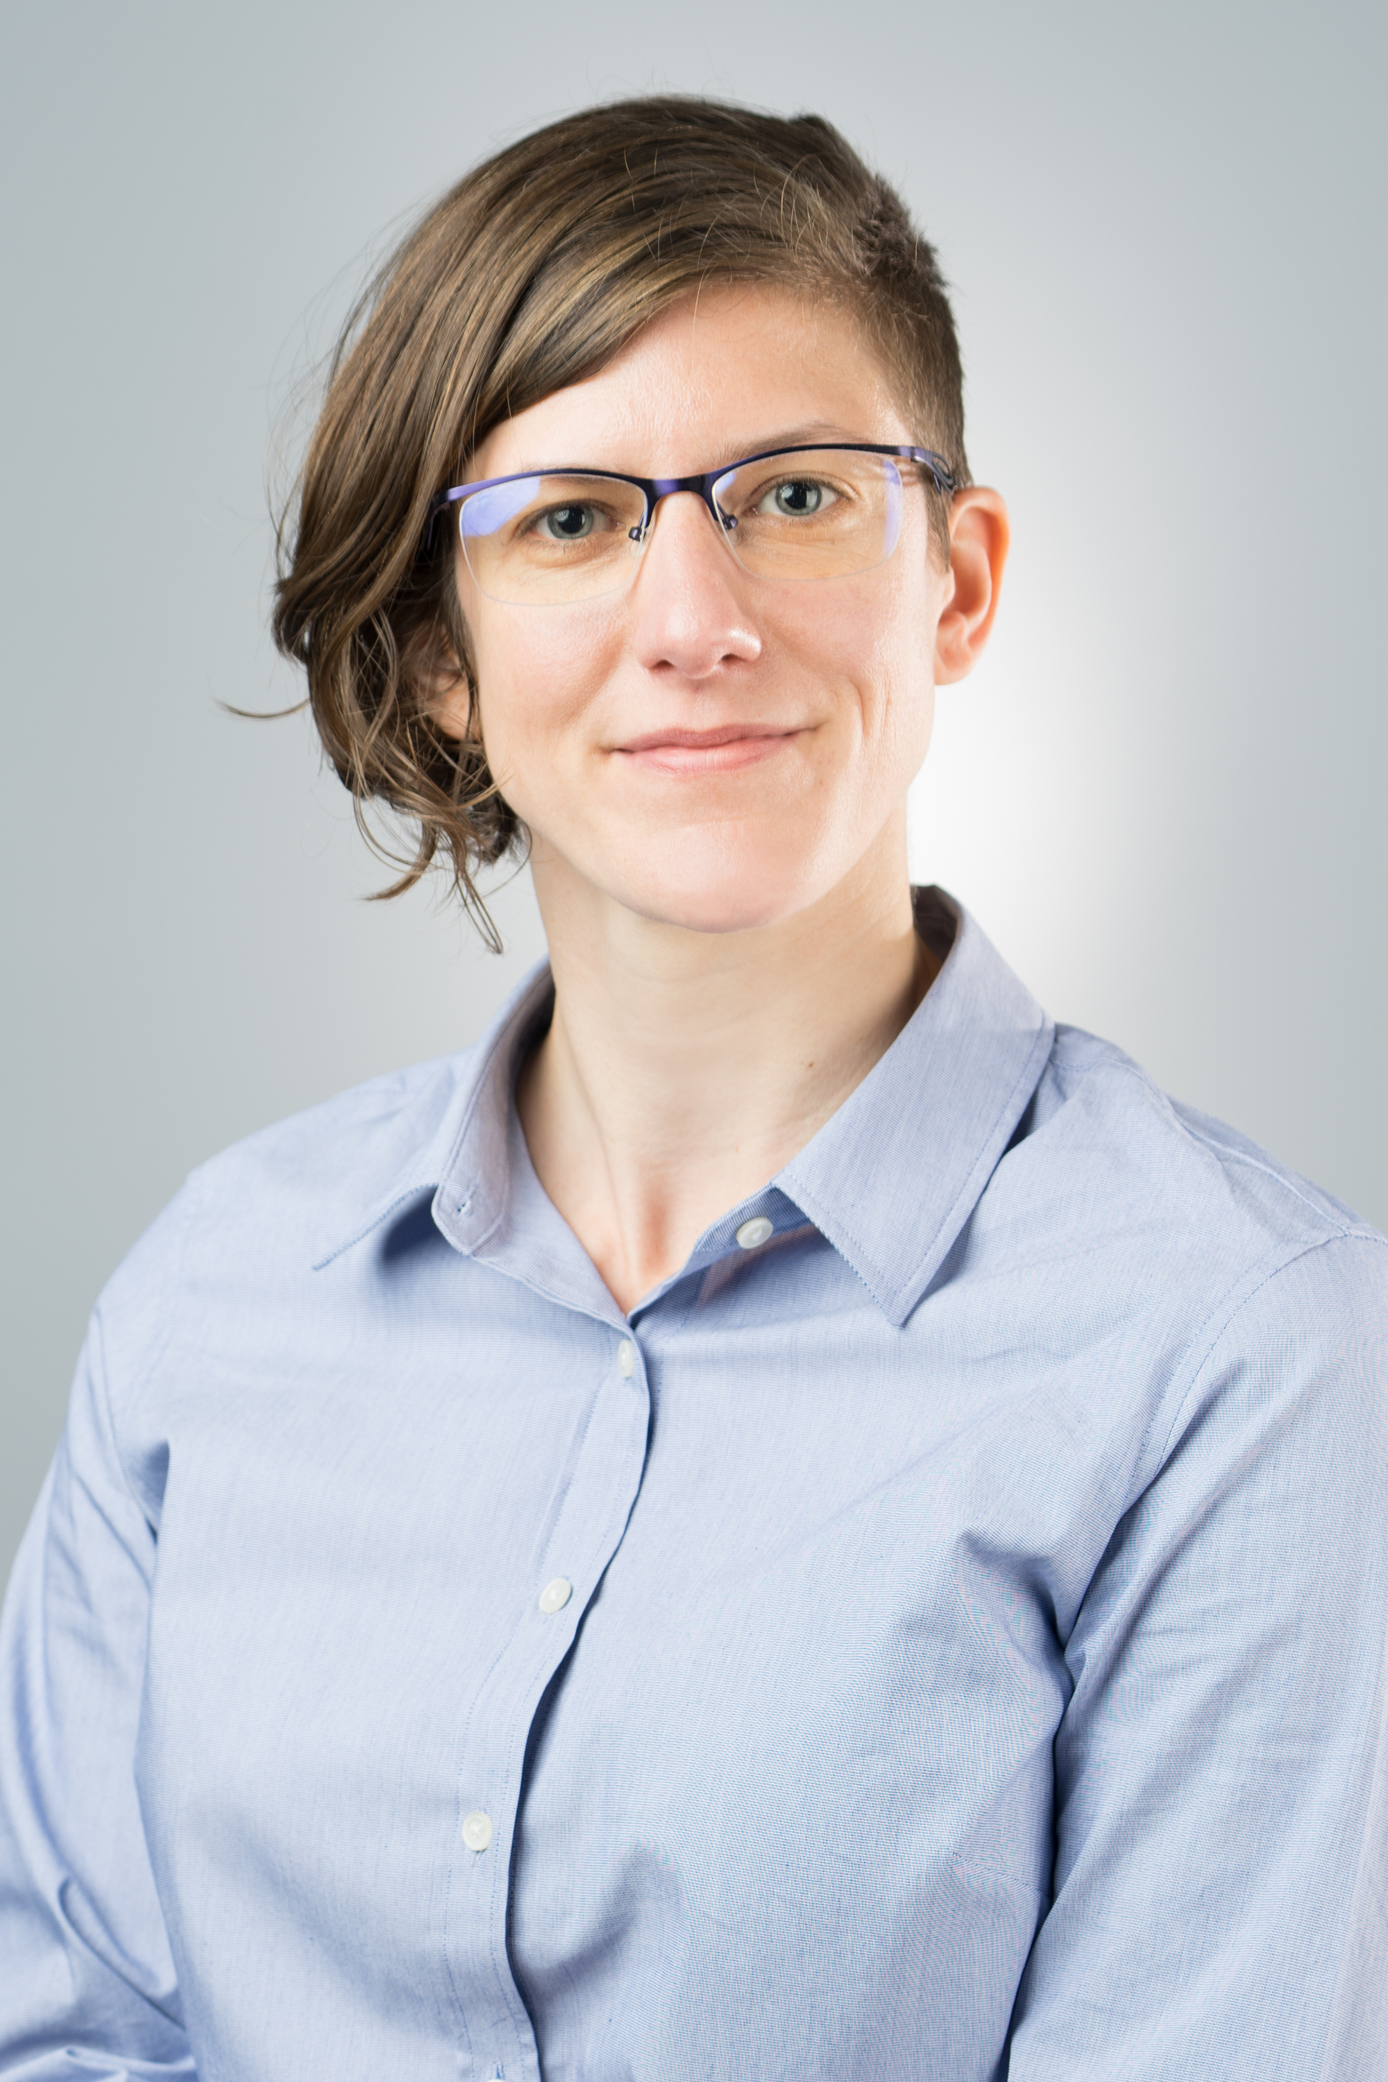
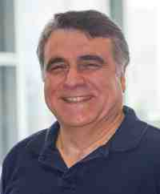
Thank you!

Slide 52
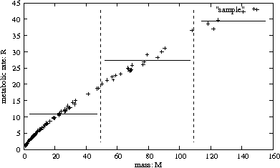
Let’s see some examples of models
Response
to new drug
Body weight

Slide 53
Let’s see some examples of models
$ spent
income

Slide 54
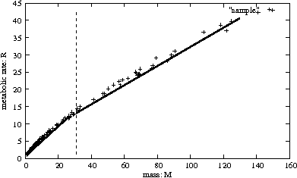
Let’s see some examples of models
$ spent
income

Slide 55
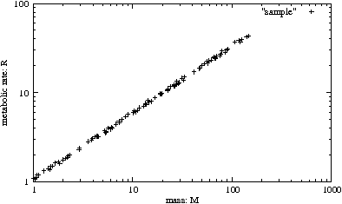
Let’s see some examples of models
$ spent
income

Slide 56
Let’s see some examples of models
$ spent
3/4
income

Slide 57
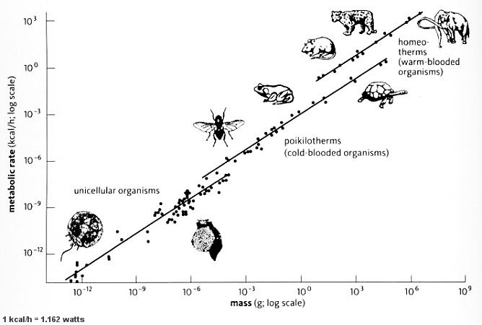
Let’s see some examples of models
Metabolic
rate
3/4
mass
http://universe-review.ca /R10-35-metabolic.htm

Slide 58
Kleiberg’s law
Metabolic
rate
3/4
mass
http://universe-review.ca /R10-35-metabolic.htm

